Slide 1
QUICK BILLING
Team Members:
G.Sandhya (1602-16-737-041)
M.Ravali(1602-16-737-032)

Slide 2
REVIEW 1
Problem Statement
Solution
Use-Cases
Technology Stack

Slide 3
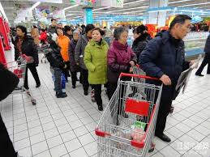
Problem Statement
Long Waitings….

Slide 4
Solution:
An App to scan the products.
Check out will be Produced

Slide 5
Use Cases:
Login through e-Mail
Notifications
Returning the products

Slide 6
Technology Stack
Android Studio
Data Base Connectivity using JDBC,ODBC

Slide 7
Thank You

